Slide 1
Financial Wellbeing as a Business Growth Driver.
Can investing in your people’s financial health really move the dial on business outcomes?
Gethin Nadin, Chief Innovation Officer

Slide 2













“Your expertise and dedication are truly inspiring”
      Author of the year 2024
      Mental Health Campaigner of
      the year 2023
      Award-Winning Psychologist
      2 x Bestselling
      HR Author
      Employee Benefits Champion 2024
      7th HRs Most
      Influential Thinkers
      Industry Influencer 2024
      Chair, Policy Liaison
      Group on Workplace
      Wellbeing
      HR Thought Leader & HR Professional of the Year 2024
      Executive Fellow,
      King’s College London
      Outstanding Contribution to
      the Industry 2024

Slide 3
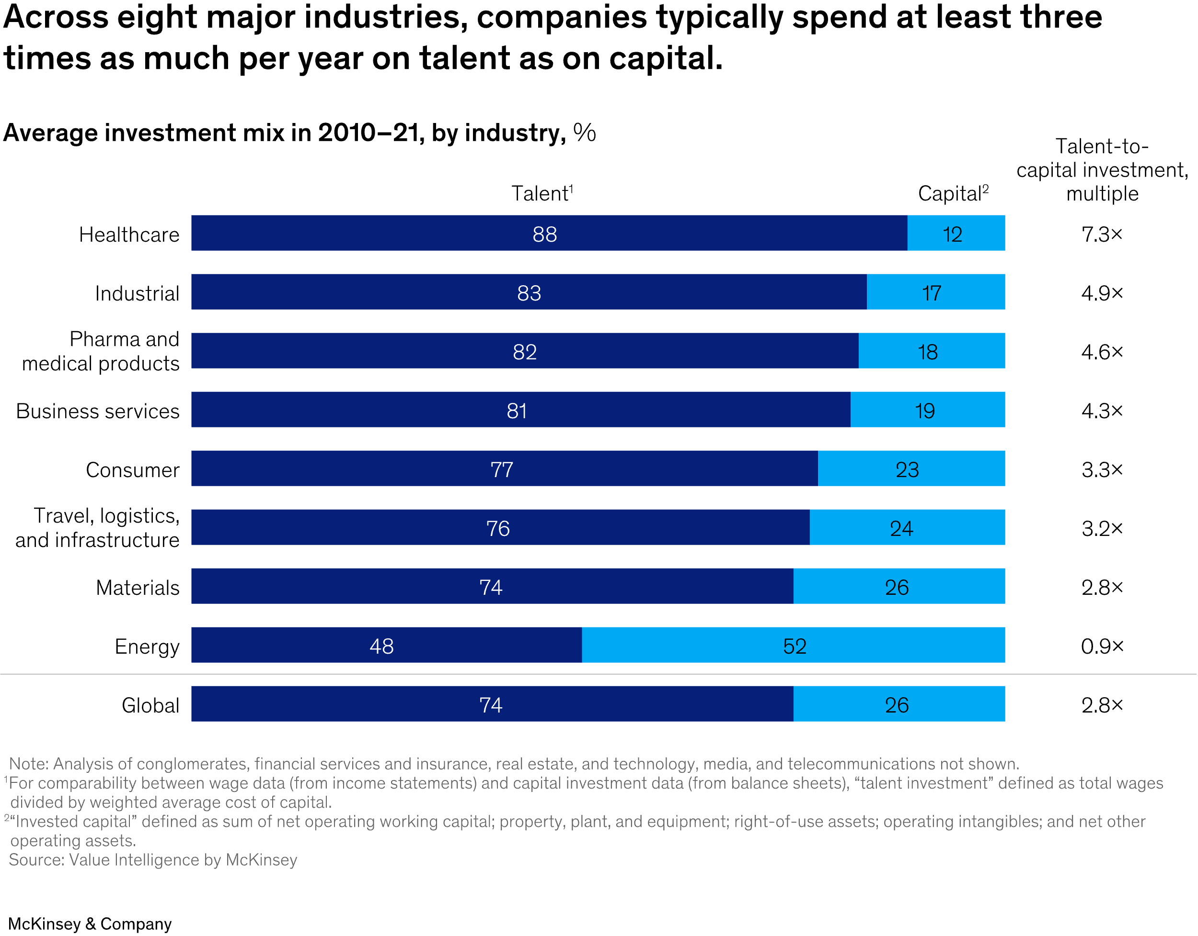

Notes:
Across all major industries, employers spend at least three times as much each year as they do on capital.
Even In capital intensive industries, more is spent on employees
High growth employers look at their employees differently – they see them as investments, not cost.
Supporting the wellbeing of our people is a way of getting more out of that significant investment.
When we look at those organisations that have outperformed their sector in productivity growth, we see that these organisations take a very different view about their labour related spending.
Across almost every sector, companies spend three times as much per year on talent as they do capital assets (software, equipment, tech, furniture, vehicles etc). This holds true even for capital intensive industries like industrial manufacturers…in fact, energy is the only sector where employers spend more on capital than on labour – and that’s only just!
But we often don’t apply the same ROI for labour as we do for capital assets. This drives us to thinking of labour as a cost… not an investment to be nurtured and grown.
Investing in the wellbeing of our largest asset is producing exciting results. When we invest in wellbeing we are maximising returns on talent investment. This shift is mindset is important because all signs point to us being able to achieve productivity breakthroughs that will help us all to sustain a competitive advantage.

Slide 4
Financial wellbeing is core to overall wellbeing.
Financial wellbeing has a direct impact on each pillar of wellbeing.

Slide 5

Financial wellbeing is core to overall wellbeing
Across ALL income levels, there is a correlation between savings accounts and overall wellbeing.
Employees with savings report better home lives, higher quality sleep and less anxiety.
Those with less than £1,000 in savings are almost three times more likely to report poor mental health than those with more than £1,000
Notes:
We even have evidence that family life gets better with even small increases in savings accounts. Employees who save money tend to have better quality sleep too. One study examined people over ten years and found that the more they saved and the more regularly they saved, the lower their financial anxiety and the better their sleep.

Slide 6

Financial wellbeing is core to overall wellbeing
There is a cyclical relationship between money and mental health
Employees with money worries are 50% more likely to report signs of poor mental health that affect performance at work
Notes:
We even have evidence that family life gets better with even small increases in savings accounts. Employees who save money tend to have better quality sleep too. One study examined people over ten years and found that the more they saved and the more regularly they saved, the lower their financial anxiety and the better their sleep.

Slide 7

Each incremental increase in financial concern equates to an additional eight preventable driving accidents.
(those in which the driver was deemed to be at fault)
Notes:
analysis of four years of nationally representative data spanning this period demonstrates clearly that experiencing mental health problems on a long-term basis has a very marked and detrimental impact on people’s financial wellbeing.
An extended struggle with either mental or financial health heightens the probability of one impacting the other.”

Slide 8



Notes:
https://www.theguardian.com/society/2025/mar/31/work-and-money-worries-young-people-more-than-culture-wars-or-climate-uk-poll-finds

Slide 9
The longer we struggle with our mental health or our finances, the greater the likelihood that one will adversely affect the other.
Money worries also make us feel lonelier.
Notes:
analysis of four years of nationally representative data spanning this period demonstrates clearly that experiencing mental health problems on a long-term basis has a very marked and detrimental impact on people’s financial wellbeing.
An extended struggle with either mental or financial health heightens the probability of one impacting the other.”

Slide 10
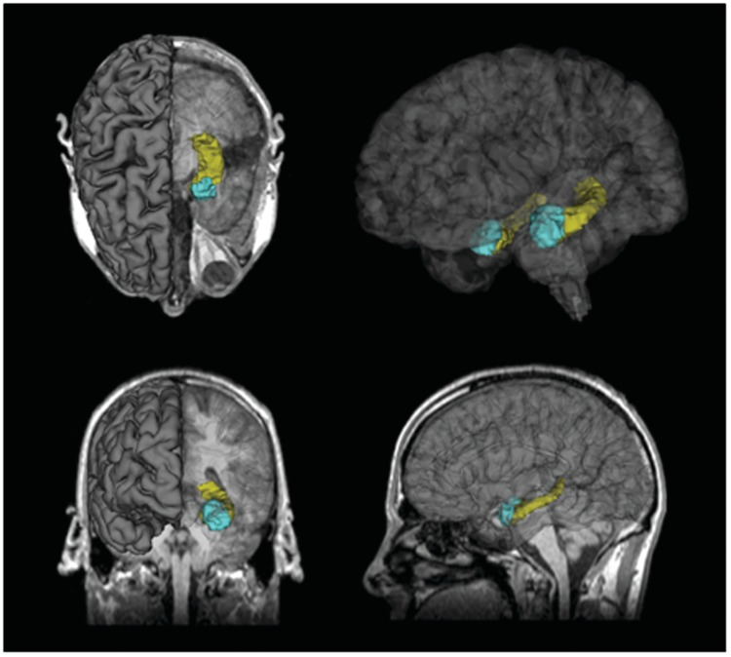
Worrying about money is such a potent
stressor that it influences
hippocampal and amygdala volumes.

Slide 11
Latest Exclusive Research:
Financial wellbeing support boosts performance
55%
More than half say financial stress hinders their ability to learn and develop new skills.

Slide 12


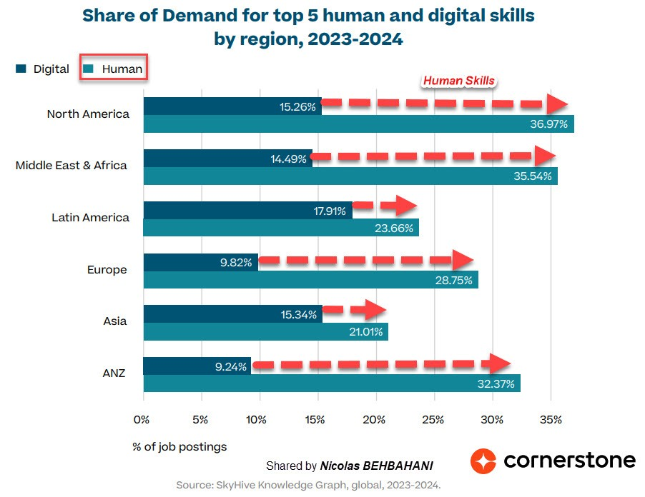
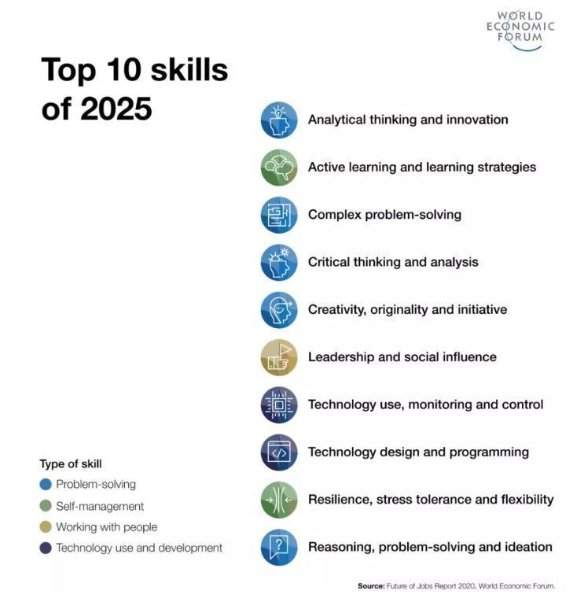

Can we have high human skills without strong financial wellbeing?

Slide 13
Financial
Wellbeing
Ignites Growth.
Employee financial wellbeing is a predictor of company financial
growth.

Slide 14

Those achieving a one-star-higher overall Glassdoor rating see a higher annual return on their assets of nearly 1%.
Reviews mentioning ”wellbeing” have increased by 44% in recent years
Notes:
Employee benefits we know are a strong motivational factor for employees.
We can even link offering benefits to a higher score on Glassdoor
And a higher score on Glassdoor to higher returns for the company
But you know all this – you are benefit professionals and have invested your time and your energy to benefits.
But what is often missing from the data and research is the impact specifically on offering benefits technology.

Slide 15
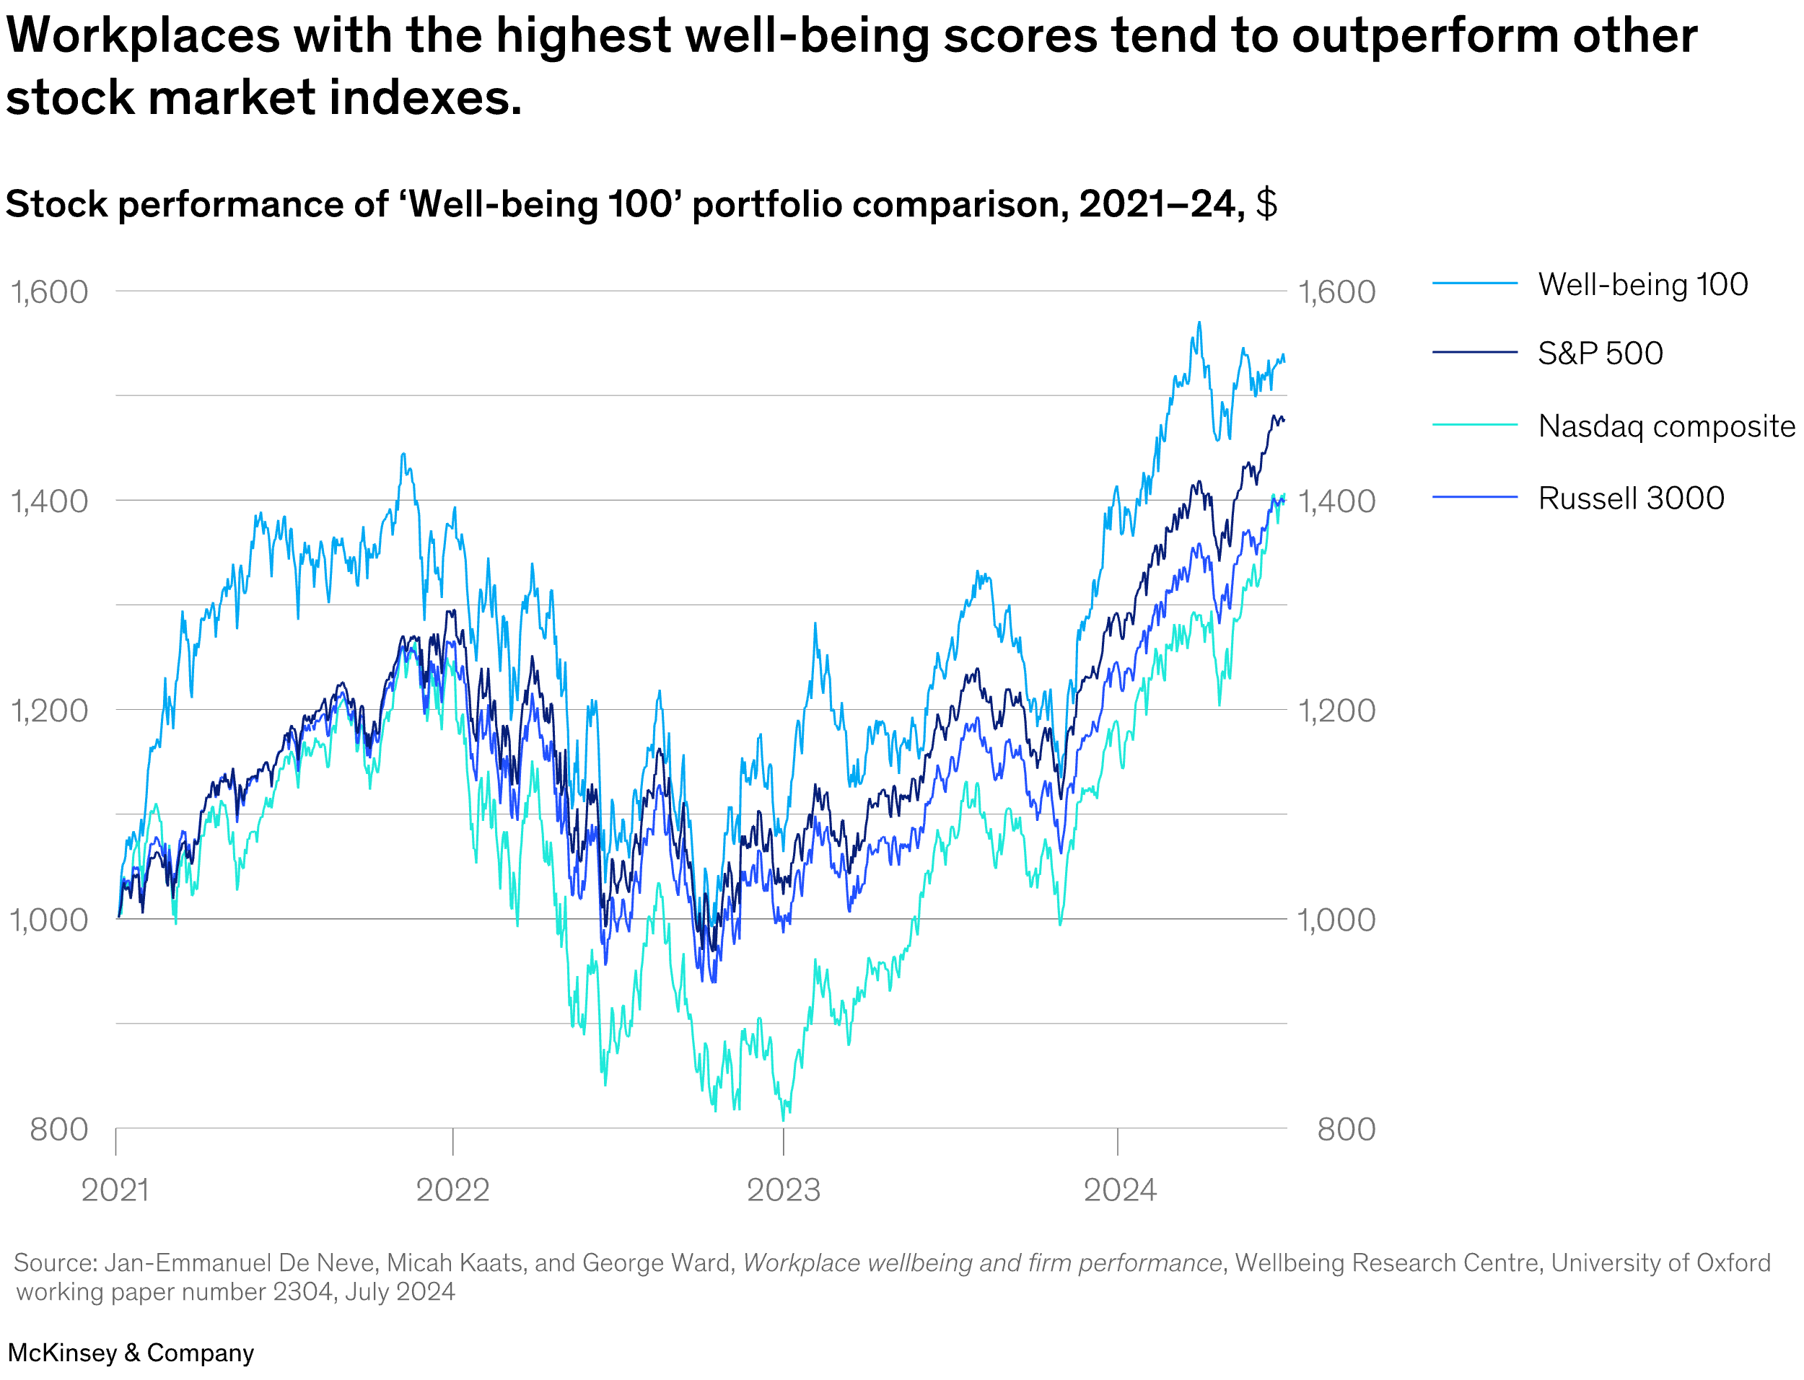

Notes:
Organisations that invest in employee wellbeing – including financial wellbeing – outperform their competitors on the stock market.
This is now so compellong that investor behaviour is changing in support of more workplace wellbeing.

Slide 16
Human Capitol Factor Score.
A statistically and independently verified link between financial wellbeing and company performance.

Slide 17
Long HCF
20.9
The high-HCF portfolio achieved an annualised return of +20.9%
(compared to just +13.3% for the MSCI overall)
Long HCF – Sector Neutral
19.2
Annualised Return (%) on Portfolios
MSCI USA Benchmark
13.3
Short HCF
The difference remains
profound when made
sector neutral
13.2
Notes:
JP Morgan looked at 600 stocks over a 10 year period and concentrated on the 30 that achieved something called a human factor score.
Stocks were assigned as having a low HCF score (short) and highest (long)
Returns are significantly higher for organisations with a higher HCF score.
For those with a low HCF score, returns are lower than average
Researchers expected that among capital light organisations like Google or Meta HCF would be more prominent than say manufacturing.
But they found the returns persisted even when the data was made sector neutral
For reference, the current average stock market returns are 10%. If you invest your money in employers that prioritise employee wellbeing, you’ll be doubling your returns!!!!
JP Morgan used the MSCI USA Index, which comprises of more than 600 stocks. Over a decade it analysed market performance and placed a concentrated portfolio of 30 stocks with the highest HCF score in the long HCF portfolio. The 30 with the lowest were assigned to the short-HCF portfolio.
They were weighted and balanced regularly to ensure a fair comparison. What is fascinating is that the analysts expected HCF to be more prominent among capital light businesses like Google or Meta and less important to high-capital businesses in manufacturing for example. But this wasn’t true. HCF was critical for every industry.
For reference, the average stock market return is 10% - so if you invest in companies who prioritise employee wellbeing over others, you are likely doubling your returns.

Slide 18
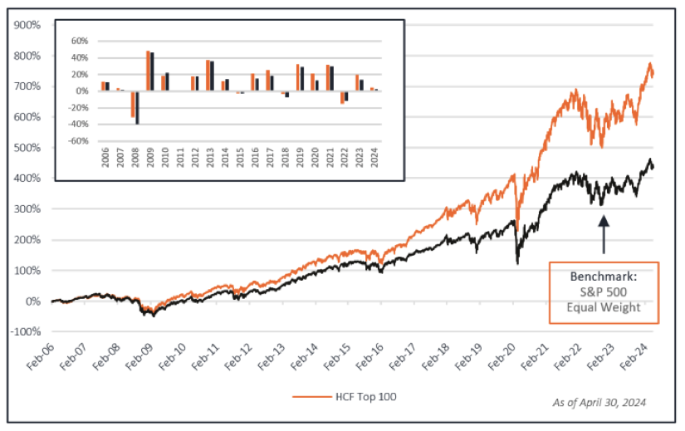

Notes:
Irrational Capital is the first firm to truly quantify the lift that a strong employee wellbeing has on a company’s stock price.
The Human Capital Factor Score has been tested and backed by JP Morgan.

Slide 19
Business Fortification.
Why financial wellbeing really matters to your organisation.

Slide 20




What does the latest research tell us?
Wellbeing acts like a shield during times of crisis.
Low wellbeing has a detrimental impact on successful mergers.
Employee wellbeing buffered against the impact of the 2008 crash.
Employers with high employee wellbeing maintain performance in economic downturns.

Slide 21
Employee Discount Schemes: Make net pay go further and enable employees to build savings buffers without decreasing spending or increasing income.
Workplace or Payroll Savings: Remove points of friction to build savings more easily.
Financial Education: Empower employees to make more confident and informed decisions.
Early Wage Access: Buffers against unexpected expenses. Acts like a safety net.

Slide 22
When the workplace supports the financial wellbeing of its people, across all industries and all major definitions of success, the organisation improves.
Financial wellbeing drives creates and sustains higher performing teams.

